Slide 1
Reading Order

Slide 2
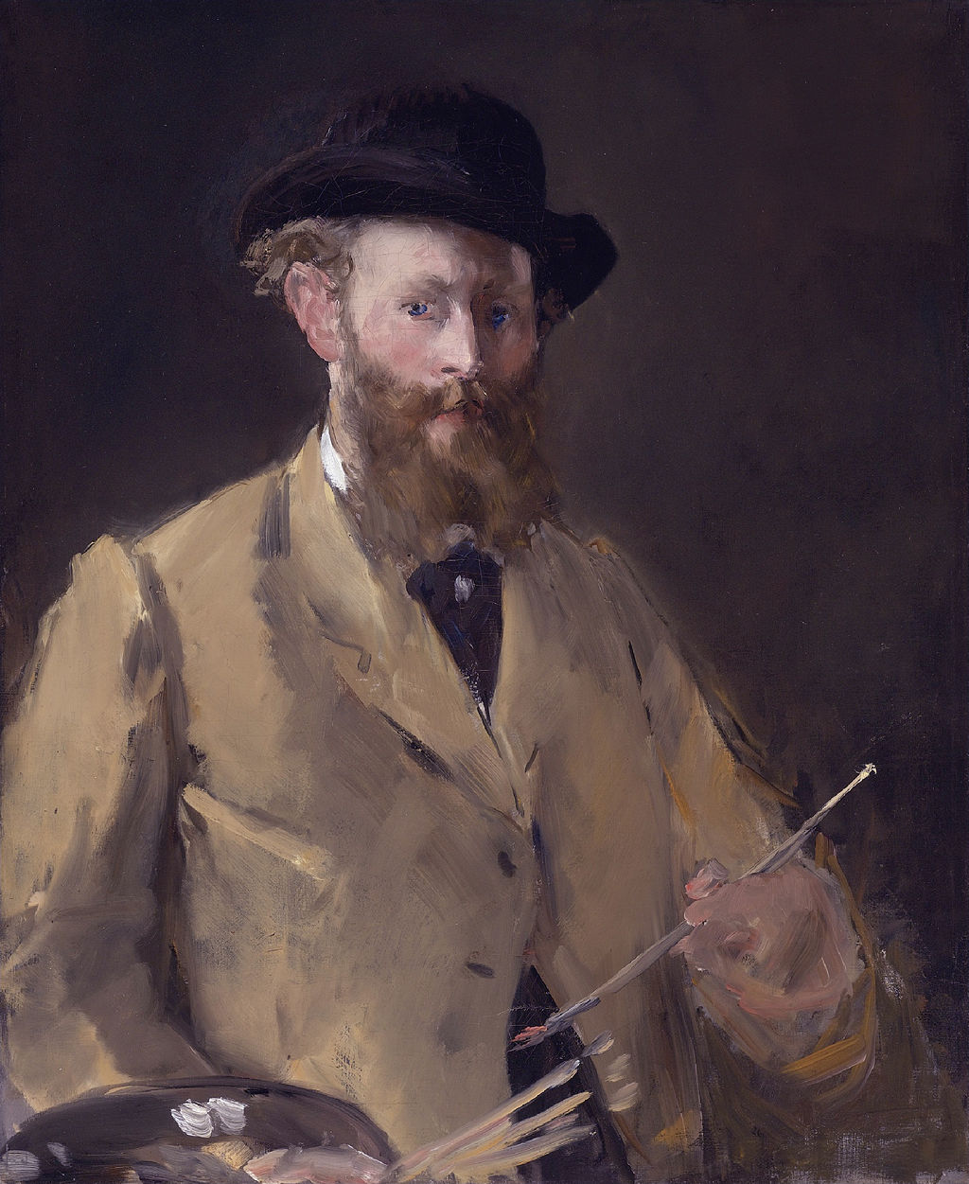
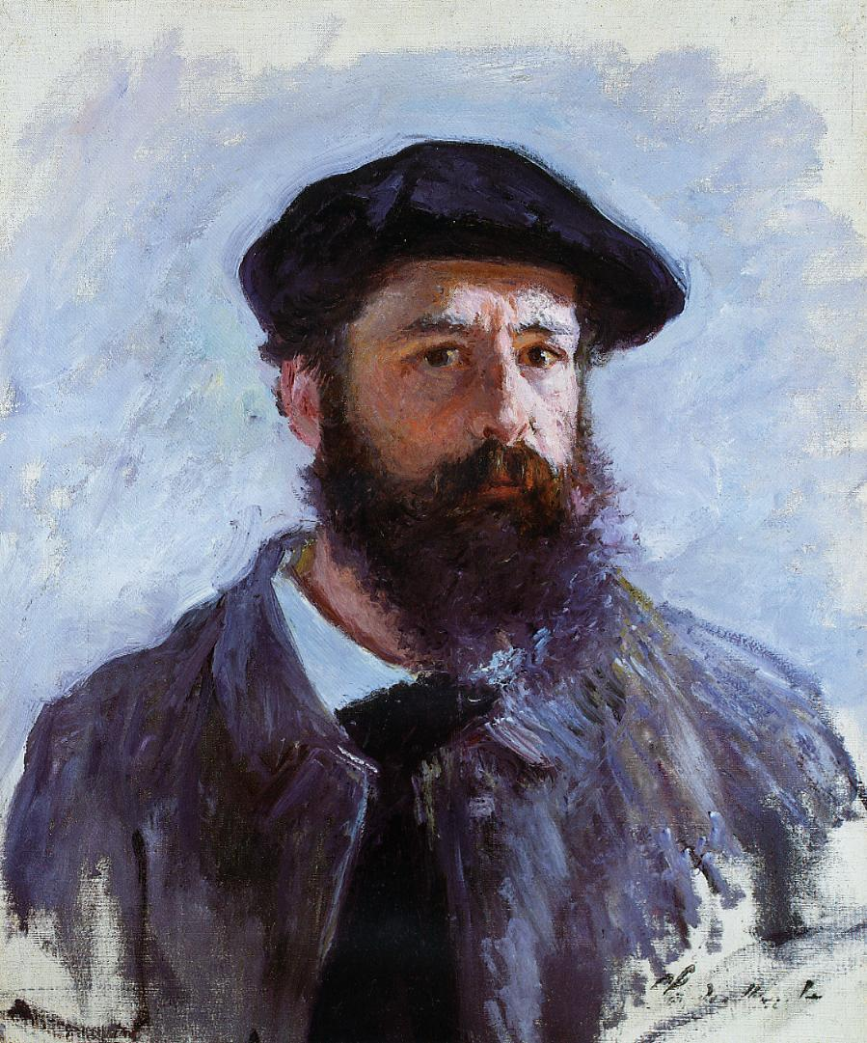
Comparing manet & monet
Edouard manet
Claude monet
Self-Portrait with Palette
Self-Portrait with Beret

